Slide 1
M6

Slide 2

Why is it important that we think of these categories of infectious agents?

Slide 3
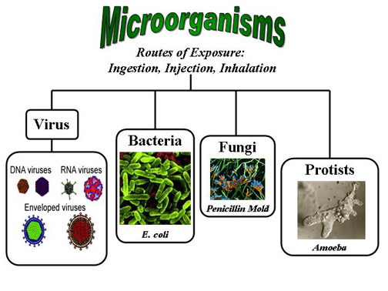
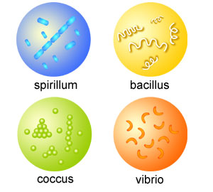
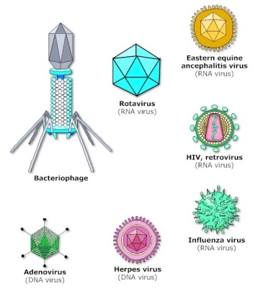
These categories are important factors in deciding what kind of treatment to use.
Members of each one of these groups – viruses, bacteria, and so on – have many biological characteristics in common.
All viruses, for example, live inside host cells, whereas bacteria very rarely do.
Viruses, bacteria and fungi multiply very quickly, while worms multiply very slowly in comparison.
Taxonomically, all bacteria are closely related to each other than to viruses and vice versa.

Slide 4

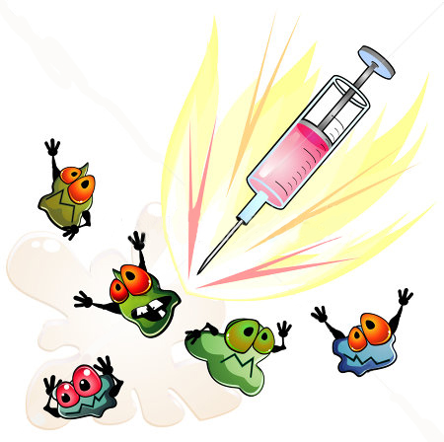
This means that many important life processes are similar in the bacteria group but are not shared with the virus group.
As a result, drugs that block one of these life processes in one member of the group is likely to be effective against many other members of the group.
But the same drug will not work against a microbe belonging to a different group.

Slide 5
As an example, let us take antibiotics.
They commonly block biochemical pathways important for bacteria.
Many bacteria, for example, make a cell-wall to protect themselves.
The antibiotic penicillin blocks the bacterial processes that build the cellwall.
As a result, the growing bacteria become unable to make cell-walls, and die easily.
Human cells don’t make a cell-wall anyway, so penicillin cannot have such an effect on us.
Penicillin will have this effect on any bacteria that use such processes for making cell-walls.

Slide 6
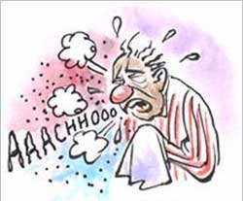
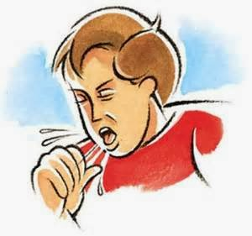
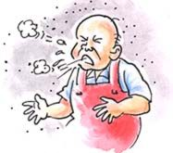


Similarly, many antibiotics work against many species of bacteria rather than simply working against one.
But viruses do not use these pathways at all, and that is the reason why antibiotics do not work against viral infections.
If we have a common cold, taking antibiotics does not reduce the severity or the duration of the disease.
However, if we also get a bacterial infection along with the viral cold, taking antibiotics will help.
Even then, the antibiotic will work only against the bacterial part of the infection,
not the viral infection.

